Slide 1
Elevate
Elevation-based Workout Navigator
Eric Atwood, Steve Borst, Yifu Liu, Jeff Muri, Kailash Srinivasan

Slide 2
Description
Elevate is a street navigation application built around workout optimization for Amherst,MA.
Given starting and ending travel points, it will display a route based on a level of workout intensity specified by the user.
Elevate will calculate a route with greater elevation changes for more intense workouts, and smaller elevation changes for less intense workouts.

Slide 3
Features
Desktop interface to input GPS coordinates for starting and ending points
Options for easy, medium, and hard mode
Easy produces the shortest path between each point
Medium produces a path with increased elevation change between points with a constraint.
Hard produces the path with the most elevation change
After requesting navigation, a map appears with the desired path
Can zoom in/out, drag to see around the map

Slide 4
Architecture
Elevate uses a model-view-controller architecture.
The view includes a user input field implemented with the Tkinter framework and a map displayed as an HTML webpage.
The model is a simple Python class that tracks user input data.
The controller is mainly based on the osmnx and networkx libraries in Python.
Used folium for the data wrangling and visualisation of maps.

Slide 5
Algorithm
Easy mode uses OSMNX version of Dijkstra algorithm with distance as the weight measure to minimise distance between the nodes.
Medium mode uses a modified version of Dijkstra with constraints between the length of the route and the elevation.
Hard mode uses OSMNX version of Dijkstra algorithm with Impedence as the weight measure to maximise elevation between the nodes.

Slide 6
Observations
There seems to be little difference between medium and hard modes over shorter distances.
Most of the times, the algorithm was able to find the path that was same as the one with shortest distance but with minimum or maximum elevation.
Doing an extensive search for all possible paths from origin to destination without a constraint for the extra distance affected the performance in hard mode.

Slide 7
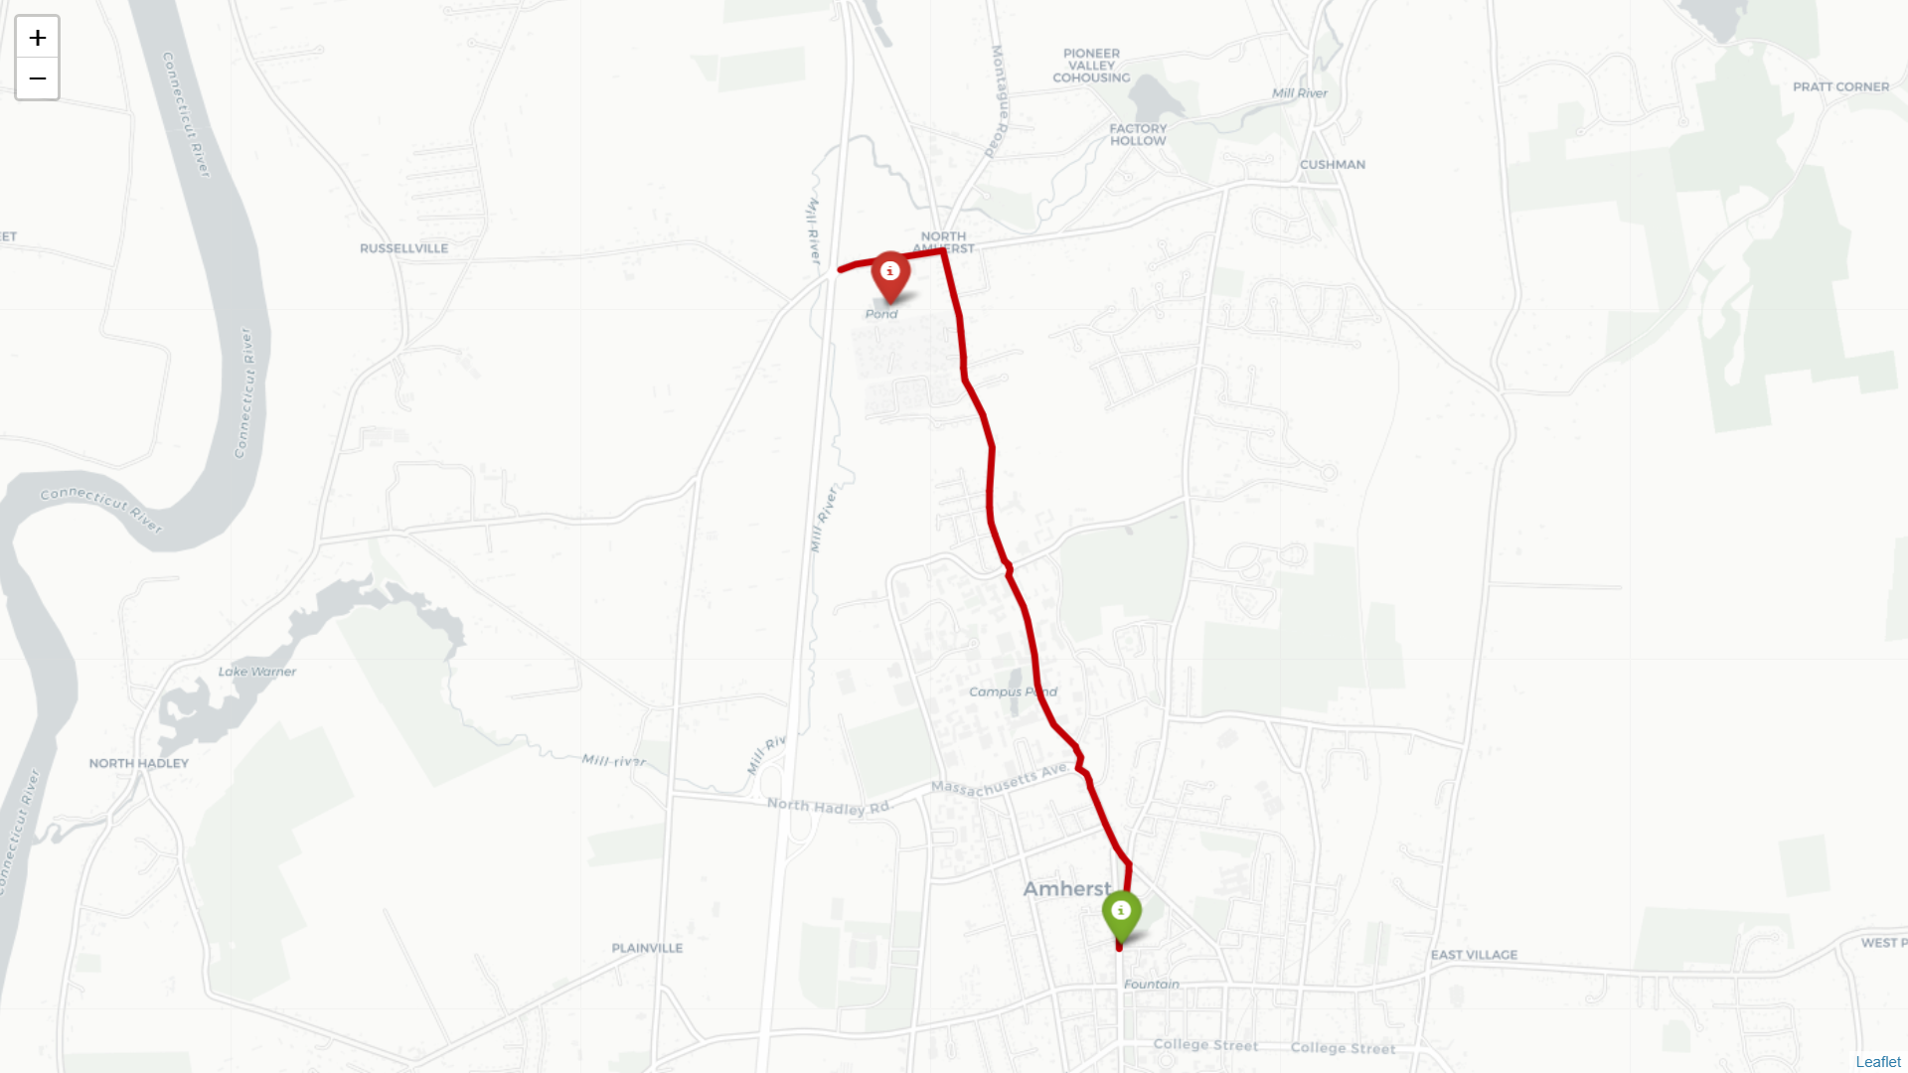
Screenshots- Easy mode

Slide 8
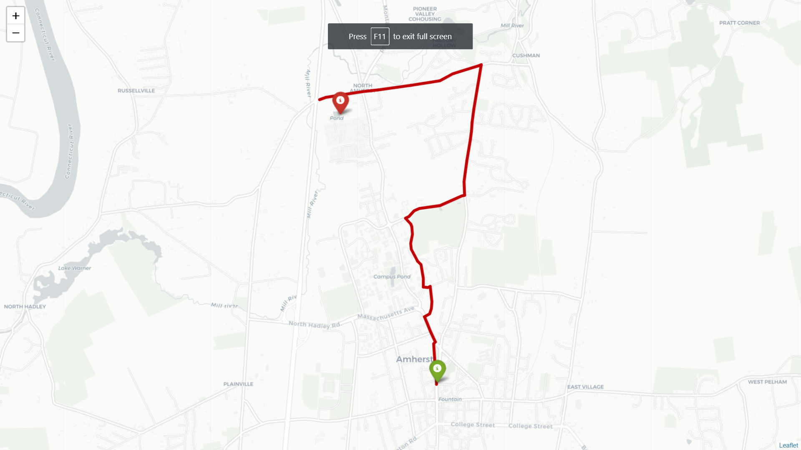
Screenshots- Hard mode

Slide 9
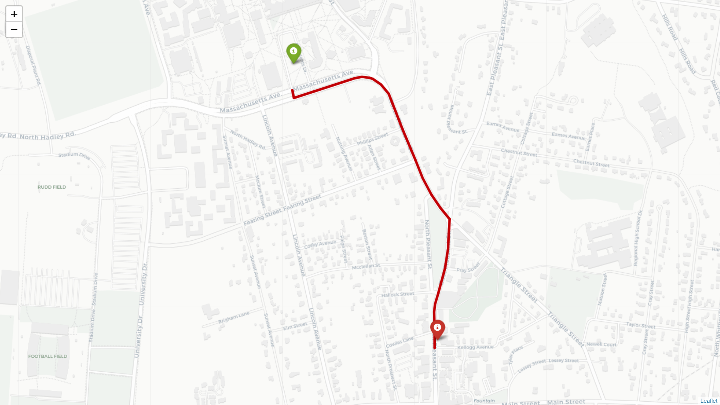
Screenshots- Easy mode

Slide 10
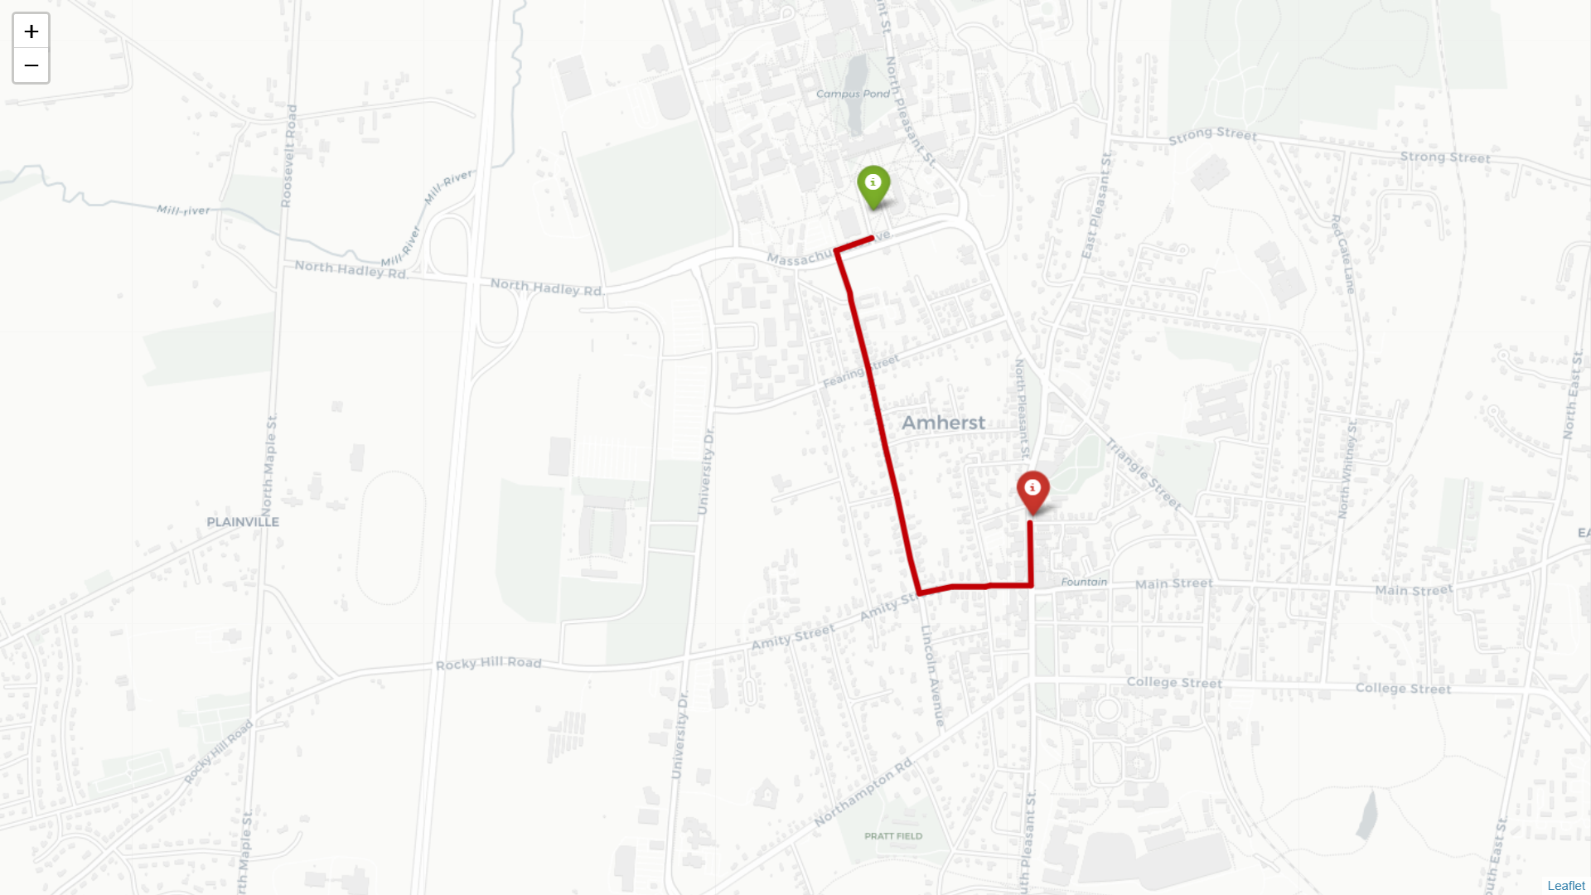
Screenshots- Hard mode

Slide 11
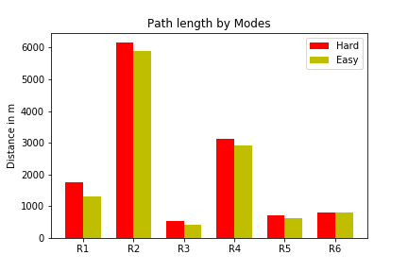
Comparison

